Slide 1
Midterm Review
ISTA 331
Spring 2020

Slide 2
Overview
Basic Test Format and General Test Taking Strategies
Necessary Data Science and Machine Learning Terminology
Probability
Classification and Confusion Matrices
Entropy and Logs
Regression, Basic Linear Algebra, and Curve Fitting

Slide 3
Test Format and General Strategies

Slide 4
Test Format
Combination of multiple choice and free response
There will be some math, but you should not need a calculator for the exam
Understand basic equations and terminology, especially understanding all mathematical symbols/expressions you have been presented
Any content from the lectures, labs, or HW is fair game
The test is meant for you to have a chance to demonstrate how well you understand the fundamentals and principles of data science taught thus far

Slide 5
General Test Taking Strategies
Study for at least 2-3 days before the exam
Get proper rest, hydration, and nutrition the night before and morning of the exam
Ask questions if you are unsure of any content or material presented to you
Test yourself before the exam
Have confidence that you will do well!

Slide 6
Necessary Data Science Terminology

Slide 7
Necessary Terminology
In machine learning (ML)…
We have data that have two main characteristics: features and instances
An instance is like an observation. It is some data we have about a real-world object or observation. These correspond to rows in a dataframe
A feature is like a variable. It is a particular thing that is observed for each observation. This corresponds to a column in a dataframe
Labelled data are data that have a target variable/label associated with them.
Machine learning algorithms can be broadly separated into two bins
Supervised machine learning requires labelled data (regression, classification)
Unsupervised machine learning does not require labelled data (clustering, dimensional reduction)
We have only covered supervised so far!
In supervised machine learning, you are always trying to achieve one of two goals
Minimization of an error/cost function
Maximization of a benefit function

Slide 8
Necessary Terminology cont.
One main purpose of supervised machine learning is to make predictions
A prediction is some sort of estimated value for a target variable. The model takes in some data and makes a reasonable guess for the value of some target variable associated with our model and data
When we are trying to predict a new instance’s target value, it is often helpful for us to model each of its features as random variables
When we model features as random variables, we are assuming that the feature value for some instance can take on more than one possible value
When making a model, you are trying to find the best combination of parameters and hyperparameters that will produce low error and have high generalizability
Hyperparameters are fixed values in a model that influence how it performs. These are like dials that you can tune to help make the model perform in a certain way
One example is the number of tokens we would use in our NLP classification project
Recall a token or a unigram in NLP is a unit of (usually) stemmed/cleaned text

Slide 9
Similarity vs. Distance in ML
When working with instances, it is often helpful for us to decide how two instances can be similar or different.
Generally, distance and similarity in ML describe how different/alike two or more instances are
Similarity is the inverse of distance: if two instances have values that are far apart in space, then they will not be similar instances
Similarity/distance can be defined in numerous ways. For example, similarity in the item-based collaborative filtering recommender system was defined by conditional probability. In curve fitting, it is defined by Euclidean Distance.

Slide 10
Probability

Slide 11
Intro to Probability
Probability is simply a quantification of chance
A probability for event B is the chance that event B will occur in the sample set
There are two kinds of probability functions:
Probability Density Function - deals with continuous random variables
Probability Mass Function - deals with discrete random variables
Often times, we can use the frequency of a particular event to get its probability
In the weather worksheets where you used conditional probability, you really used frequencies rather than probabilities
If you are counting, then you are using frequencies!

Slide 12
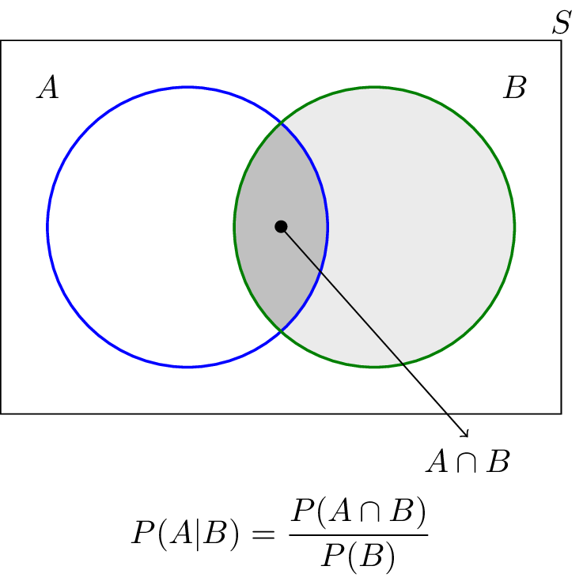
Conditional Probability
Instead of just asking about the probability of a particular event, we can also ask about the conditional probability of an event GIVEN another event
In the picture below, we are trying to find the probability of event A given B occurs
Precisely, this is just the probability of both A AND B occurring divided by the probability of B (the given)
Notes:
https://www.google.com/url?sa=i&source=images&cd=&ved=2ahUKEwj0ppHgsprlAhWWoJ4KHWGBCp0QjRx6BAgBEAQ&url=https%3A%2F%2Fwww.probabilitycourse.com%2Fchapter1%2F1_4_0_conditional_probability.php&psig=AOvVaw1Yb6b3jzrhWPIRsl8Y0It6&ust=1571095968966966

Slide 13
Classification and Confusion Matrices

Slide 14
Intro to Classification
Classification in machine learning/data science is the process of predicting which class an instance belongs to
Since classification is trying to ascribe a class label to a new instance, this is an example of supervised machine learning
Classification is used when the target variable is a categorical rather than numerical variable
There are several kinds of classification algorithms, such as:
Naive Bayes
Logistic Regression
Support Vector Machines,
Decision Trees
Many more!

Slide 15
Classifying Text
In order to structure text data in a way that classification algorithms can use, we must form term frequency vectors
To form these… (for unigram text analysis)
Take each word that appears in the text that is not a stop word
A stop word is a basic word that adds no context or full meaning to a sentence. Think “a”, “the”, “I”, “an”, etc.
Stem the word to its basic form → Now we have a token
Either add the token to the dictionary or increment its frequency count
Run the classification algorithm on the term frequency vector!
You may need to limit the number of tokens or mess with other hyperparameters to ensure viable results

Slide 16
What is a Confusion Matrix?
A confusion matrix is a matrix that summarizes the results of training/observing a classification algorithm
Naïves Bayes, Logistic Regression, k-Nearest Neighbors, etc.
It is a tool to evaluate a classifier, since metrics such as accuracy, reccall, and precision can be easily measured
Since most of our cases concern usually a binary class output (spam/not spam, True/False), we will only go over 2x2 examples, but this is generalizable to nxn for n class outputs
In Python, can be imported from sklearn.metrics and takes a list of predictions and a list of the associated correct labels as the arguments

Slide 17
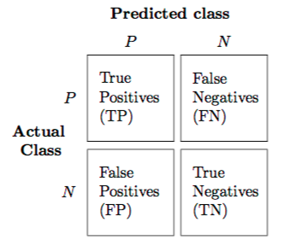
Example of a Confusion Matrix
Notice how confusion matrices only make sense when we have the “true” or “actual” outcome. Think about what each of these cells represents. For example, a False Negative (FN) is where the classifier thought the value was negative, but it is actually positive.
Notes:
Mention how positive doesn’t always literally mean positive or good; it refers to what we care about in this context regardless of the connotation
Pic link: https://www.google.com/url?sa=i&source=images&cd=&ved=2ahUKEwiTnYiWz9HkAhXIneAKHR84CDcQjRx6BAgBEAQ&url=https%3A%2F%2Fmedium.com%2Ftech-vision%2Fintroduction-to-confusion-matrix-classification-modeling-54d867169906&psig=AOvVaw3_xB1ag1cnPOmtbPdT9HUR&ust=1568595336270406

Slide 18
Key Formulas Related to Confusion Matrices
Precision
Probability that an instance is positive given the classifier thought it was positive
Also known as positive predictive value
Precision = TP/(TP + FP)
Accuracy
Probability that the classifier predicts the right or “accurate” class value
Accuracy = (TP+TN)/(TP+FP+FN+TN)
Recall
Given a positive instance, what is the probability that the classifier will predict positive
Also known as sensitivity or true positive rate
Recall = TP/(TP+FN)

Slide 19
Entropy and Logs

Slide 20
Quick Log Facts
A logarithm function is the inverse of an exponential function
But, a logarithm itself IS an exponent!
log_{b}(a) = x IF b^{x} = a
EX: log₂(8) = 3 SINCE 2³ = 8
Memorize (and be able to show/explain) these!
Product Rule: log_{b}(mn) = log_{b}(m) + log_{b}(n)
Quotient Rule: log_{b}(m/n) = log_{b}(m) - log_{b}(n)
Power Rule: log_{b}(m^{n}) = n * log_{b}(m)
Zero Rule: log_{b}(1) = 0 IF AND ONLY IF b != 0
(Other) Zero Rule: log_{b}(0) = undefined
Identity Rule: log_{b}(b) = 1
Change of Base: log_{b}(x) = log_{c}(x) / log_{c}(b)
This is NOT a math class! But we use logs so often these are just important to know and explain so we can use them to solve problems!

Slide 21
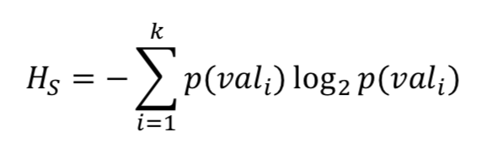
Information Entropy
The big “E” means sum.
The entropy is the sum of the product of each value’s probability of occurring and the log of that probability
Entropy is a measure of how ordered/disordered a set is!

Slide 22
Information Entropy Example
Imagine we have a dataset of some berries with the probabilistic frequencies shown to the left
The information entropy for the set of data is…
H_{s}= -(-½ + -½ + -½ ) = -(-3/2) = 3/2
Value | Tomato | Banana | Avocado
P(Value) [1] | 1/2 | 1/4 | 1/4
log₂(P(Value)) [2] | -1 | -2 | -2
[1] * [2] | -1/2 | -1/2 | -1/2

Slide 23
Regression, Basic Linear Algebra, and Curve Fitting

Slide 24
Basic Linear Algebra
A vector is a 1xN or Nx1 collection of some data
If it is 1xN, it is a row vector; Nx1 is a column vector
It is possible to turn a row vector → column vector by taking its transpose
Quick Vector Facts
Vector addition is commutative and associative
If two vectors are perpendicular, then the angle between them is 90º
If two vectors are scalar multiples of each other, their separating angle is 0º
A matrix is a collection of vectors, or a vector of vectors.
It is usually referred to as “a N by M matrix”, where n is the number of rows and m is the number of columns
Quick Matrix Facts
Matrix addition is commutative and associative
Any invertible matrix multiplied by its inverse is the identity matrix
If a matrix has NxM dimensions, then the transpose will have MxN dimensions

Slide 25
Dot Product Formulas
There are two common formulas for the dot product between two vectors:
Using Sums
U ● V = 𝝨(U_{i}V_{i})
Using the Angle between Two Vectors
U ● V = (cos(𝝧)) * (||U|| * ||V||)
Here, ||U|| is the magnitude of U, which is the square root of U ● U
Remember, a dot product always returns a scalar, not a new vector. The dot product is also commutative. Perhaps, it might also be necessary to manipulate either equation to solve for a magnitude or cos(𝝧)

Slide 26
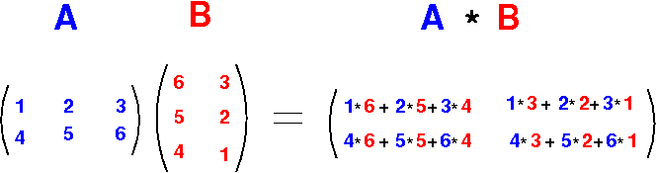
Matrix Multiplication Example
Here, A is a 2x3 and B is a 3x2 matrix. In general, the if A is a NxP, then B must be a PxM to multiply and the result will be NxM
Notes:
https://www.google.com/url?sa=i&source=images&cd=&ved=2ahUKEwiwyIeP1prlAhWQvZ4KHX0GAfwQjRx6BAgBEAQ&url=http%3A%2F%2Fwww.mathcs.emory.edu%2F~cheung%2FCourses%2F554%2FSyllabus%2F9-parallel%2Fmatrix-mult.html&psig=AOvVaw2h4Or8n0NZOZed9yjoGRLg&ust=1571105468230295

Slide 27
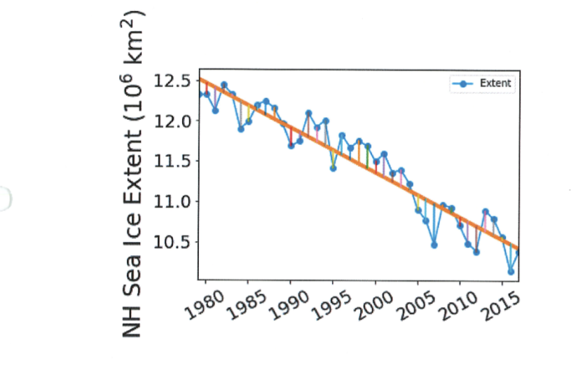
Regression and Curve Fitting
Curve fitting is the process of fitting a function to some data
It is the main component of making a regression model
Regression is the process of predicting the target value (numeric) for a new instance
The best-fit curve is the one that minimizes the sum of squared residuals
One algorithm that we use to compute the coefficients of the best model is Ordinary Least Squares
A residual is the difference between what a model predicts a value is and what it actually is
The main function we use to evaluate the model is the Root Mean Square Error
RMSE = √(Σ residual_{i}² /(N-ddof))
Ddof is either almost always 0 or 1
It is possible to fit non-linear polynomials and other functions to data using the same principles
The blue points/line are the actual data, the orange curve is the best-fit curve, and the lines from each point to the orange curve are the residuals
Notes:
Image from Rich’s Curve Fitting Notebook

Slide 28
Function Transformations
While not often always as simple as it seems, it is at times useful to know how a certain function was transformed from the original
Here, “a” always represents the stretch/shrink factor. If a < 0, then the function is flipped over the x axis
For polynomials
f(x) = a * (x-b)^{n} + c
Vertical shift is modeled by c
Horizontal shift modeled by b (if b>0, then the function moves to the right)
For Sine / Cosine
f(x) = a * sin(bx + c) + d (swap out sin for cos if you want cosine)
Here, b,c control how often the period happens (b) and where it is shifted from (c)
Vertical shift modeled by d

Slide 29
Questions?

